Slide 1
CS 410 – Sentiment Analysis
Liu, Ling-Hsi (lhliu2@illinois.edu)
Nishant Gulgulia (nishant9@illinois.edu)
Pradeep Khandelwal (pk5@illinois.edu)

Slide 2



Team Introduction
Liu, Ling-Hsi
Nishant Gulgulia
Pradeep Khandelwal

Slide 3
Project Overview
Sentiment analysis on political figure
Collect tweets from twitter
Store them and analyze
Perform sentiment analysis
Build dashboard

Slide 4
Goal
Understanding about NLP
Understanding about AWS and it’s managed services Athena, QuickSight, Amazon Comprehend
Build generic framework to analyze sentiment analysis
Understand advantages and limitations of managed services like AWS Comprehend
Build working model of sentiment analysis

Slide 5
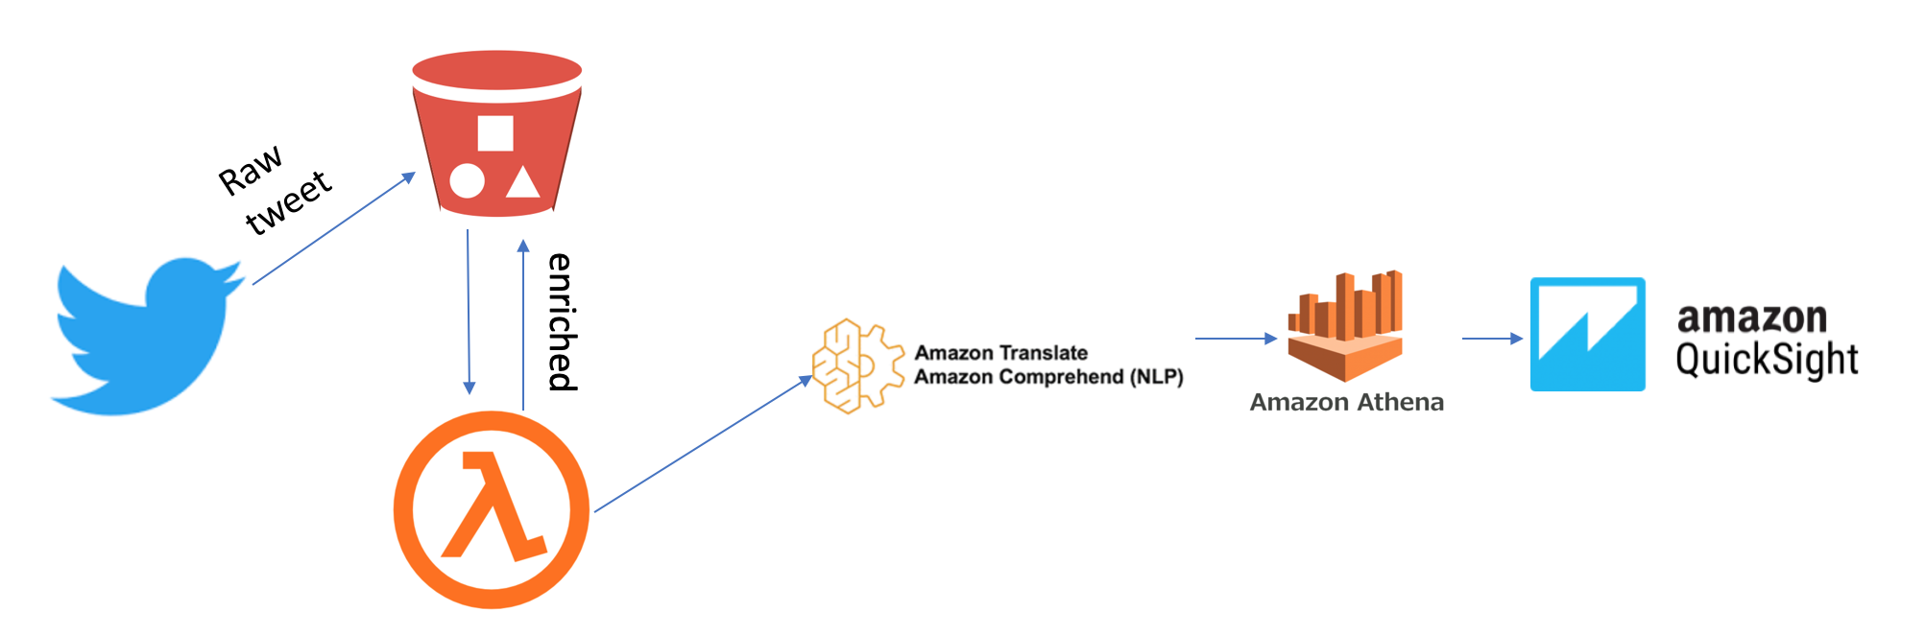
Architecture Diagram

Slide 6
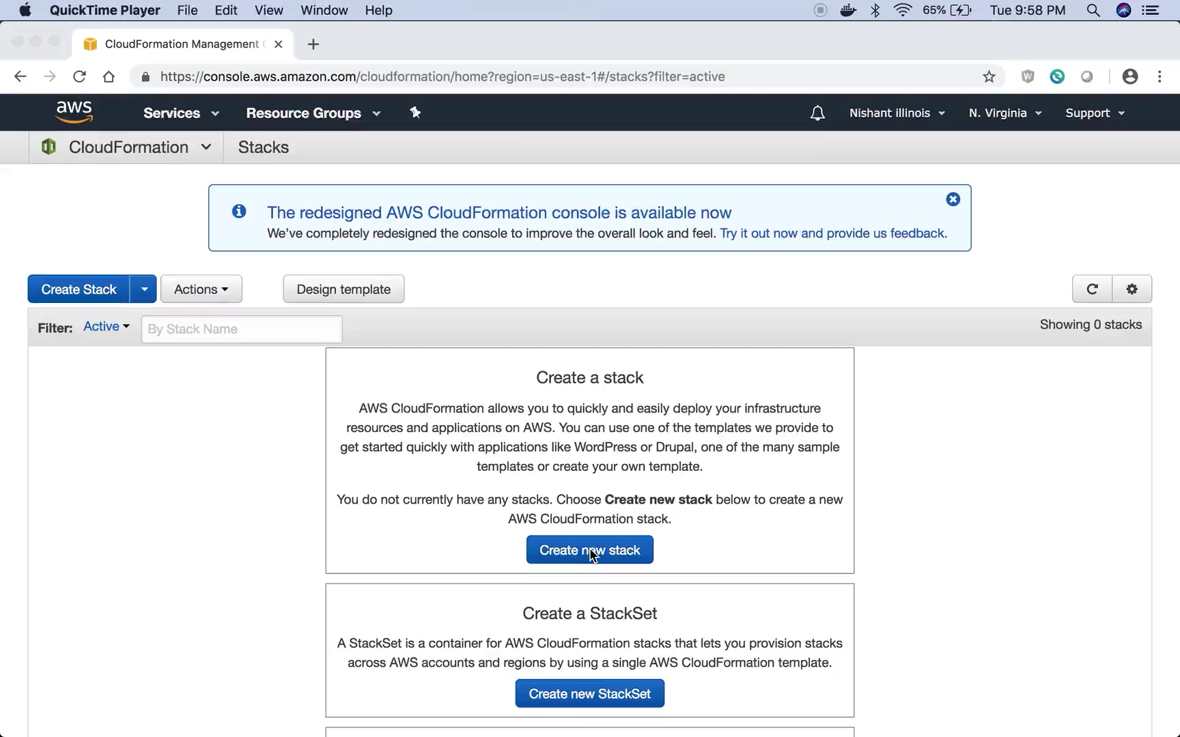
Demo

Slide 7
Future Enhancements
Explore other managed services with similar dataset
Build complete server-less infrastructure
Add amazon Kinesis and Glue to provide real time streaming and sentiment analysis
Containerize solution and add to fargate

